Slide 1

Rotary Club of Makati,
Philipines
International Toast
August 6, 2025
International Toast
August 6, 2025

Slide 2
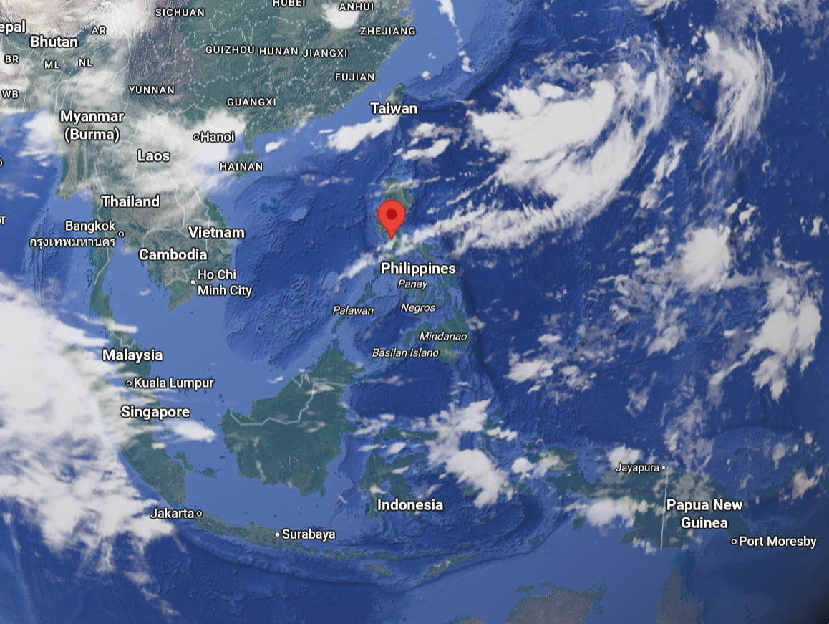
International Toast
August 6, 2025

Slide 3
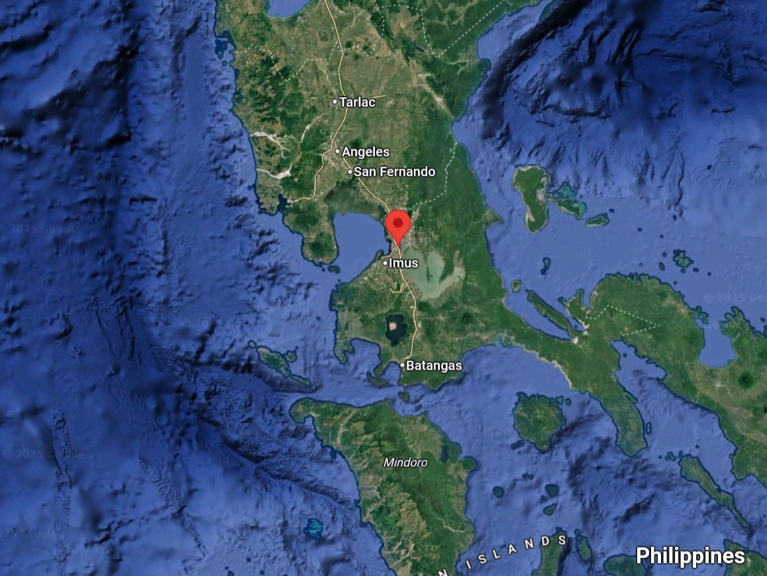
International Toast
August 6, 2025

Slide 4
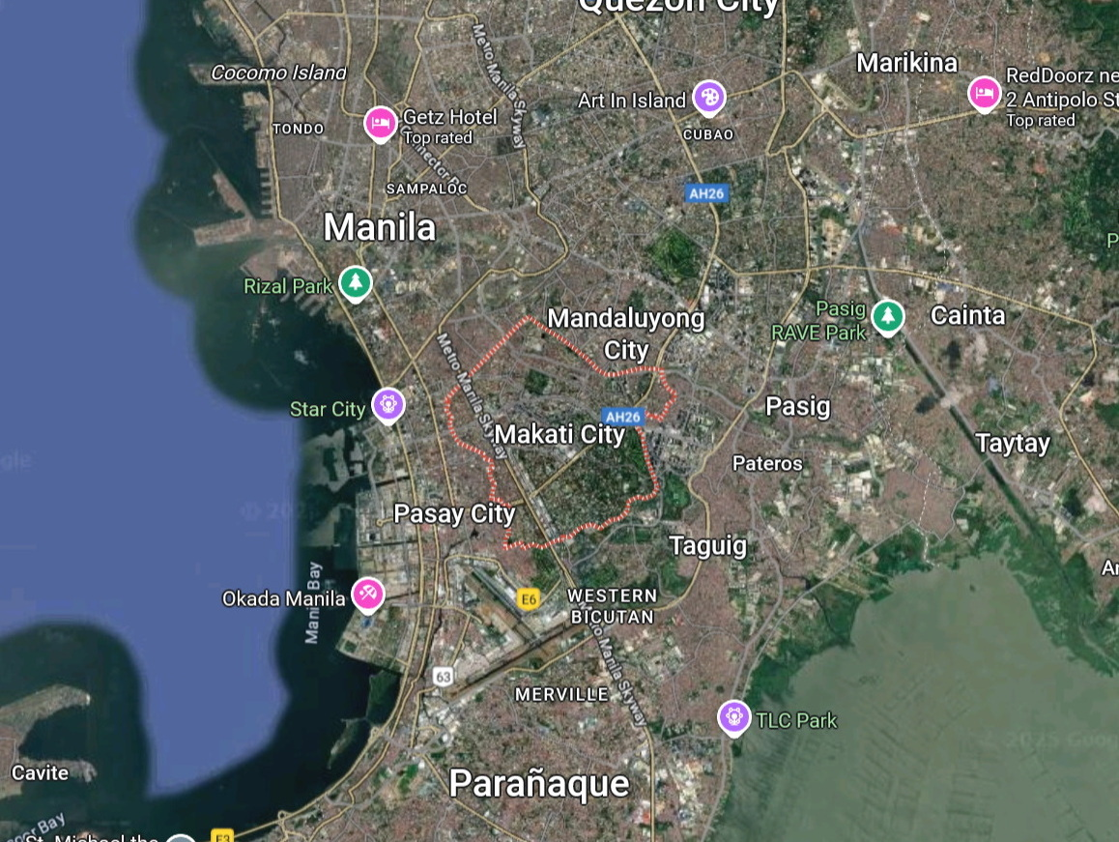
International Toast
August 6, 2025

Slide 5
International Toast
August 6, 2025
The Rotary Club of Makati, Philippines: founded 1966, known for major humanitarian work
Current membership of about 130 composed of businessmen and professionals. Half are CEO’s or CFO’s, A quarter heads or senior officers of financial institutions.
Members include a past RI Director and seven District Governors
One of Southeast Asia’s largest and most active clubs
Known for sustainable, high-impact projects
Strong partnerships with hospitals, government, and international clubs

Slide 6
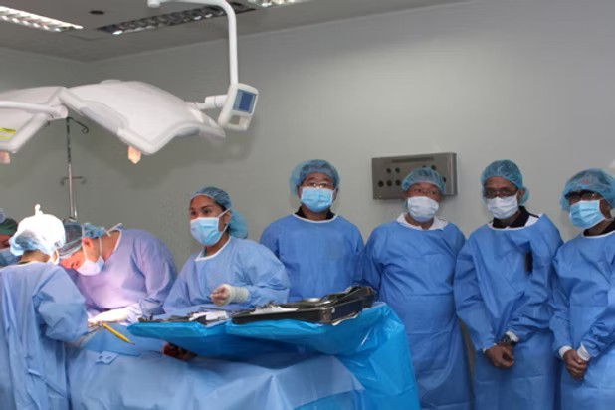
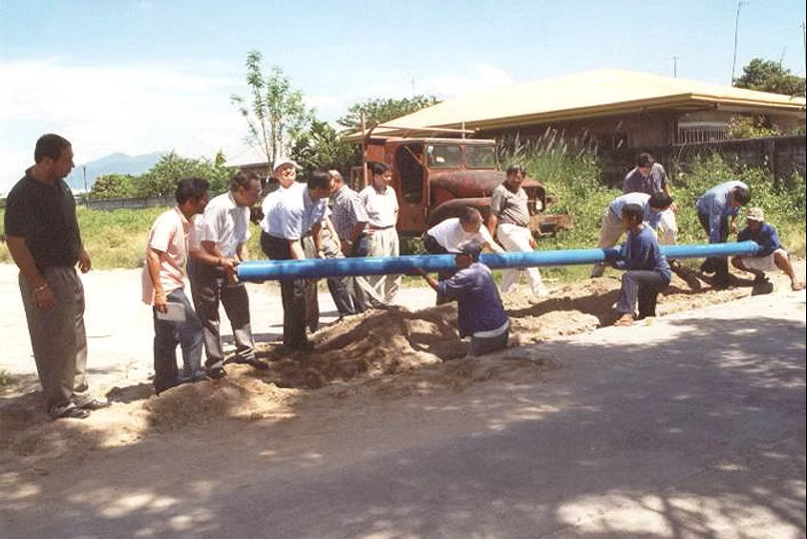
International Toast
August 6, 2025
Rotary International’s project to eliminate polio started here in 1979
TB prevention
Free surgeries for the poor
Medical and dental missions for the poor
Breast and cervical cancer screening
A number of clean water projects

Slide 7

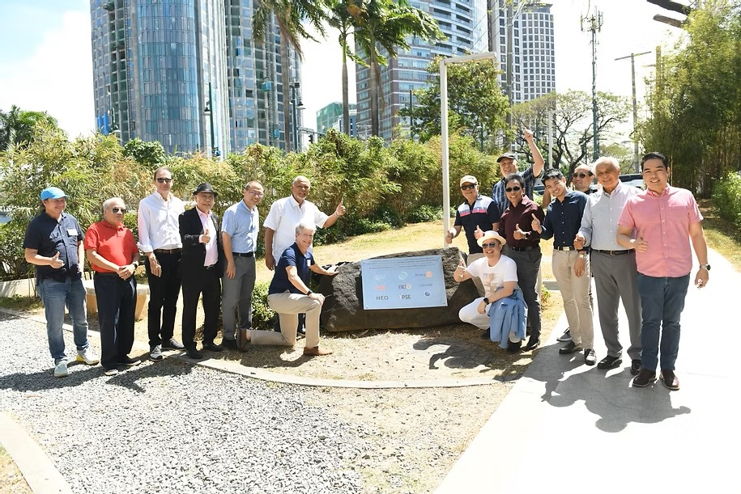
International Toast
August 6, 2025
Nutrition program for pre schoolers
A number of education and literacy programs including provision of books, teaching the deaf, and teacher training programs.
Career guidance programs and support for community development
A drug rehabilitation project
A number of environmental projects including reef protection, community gardens, re forestation and air quality

Slide 8
International Toast
August 6, 2025
The Club has received many District awards such as most outstanding Club and six of its members have received the RI Service Above Self Award.
RI has honored the club with two Significant Achievement Awards, the first for establishing its funding arm, the Makati Rotary Club Foundation, Inc., and the other for Project Angels, an environmental advocacy program for the youth.
The Club has sponsored the formation of 12 clubs, all of which have grown in stature and contributed to the growth of the District.
The Club has consistently been the District’s biggest contributor to The Rotary Foundation with an aggregated contribution of about US$3m
The Club has, or has had, four Arch Klumph Society members and currently has 29 “major donors”.

Slide 9
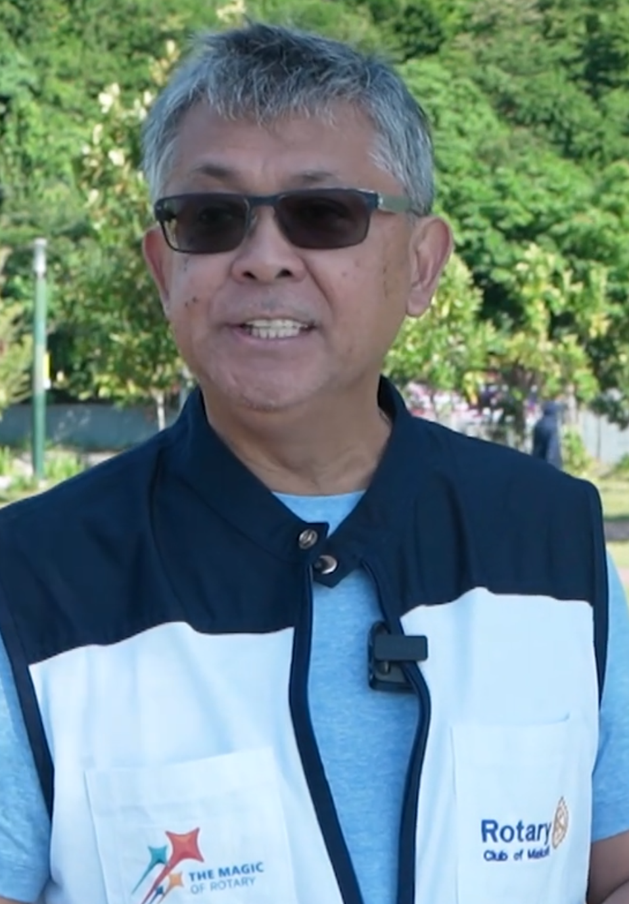
International Toast
August 6, 2025
The Club meets every Tuesday at noontime at the Conservatory of The Manila Peninsula.
Current President is Eduardo Galvez
A toast to President Eduardo Galvez and the
members of the Rotary Club of
Makati, Phillipines
rotaryclubmakati.org

